Slide 1
Naybrr
Josh Cormier
Jamila Sisco

Slide 2
Delivr
App for deliveries
Customers order from multiple locations on route
Drivers can select routes and get paid
Vendors can manage directly and get paid
Work with small businesses without overhead

Slide 3
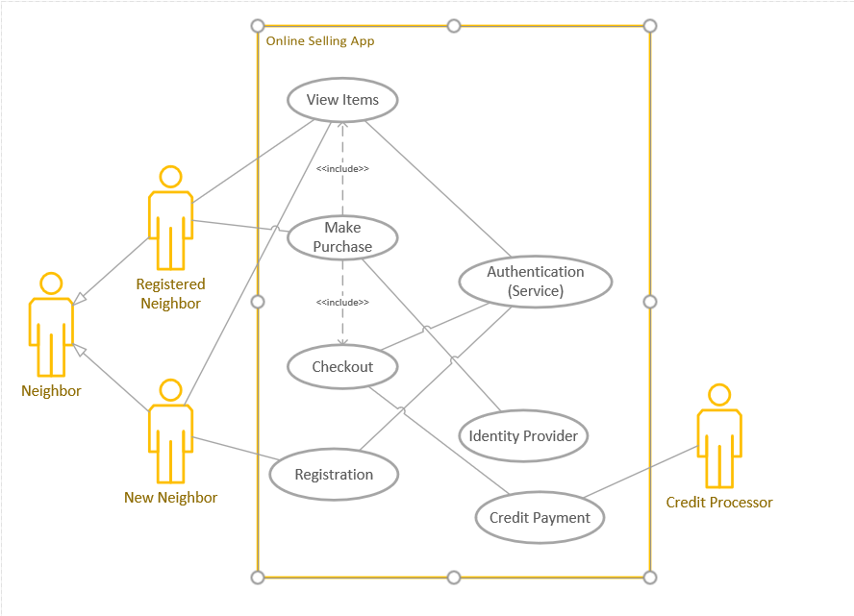
Use Case
Neighbor
Sign Up or Log In
Make Purchase
Sell
Checkout

Slide 4
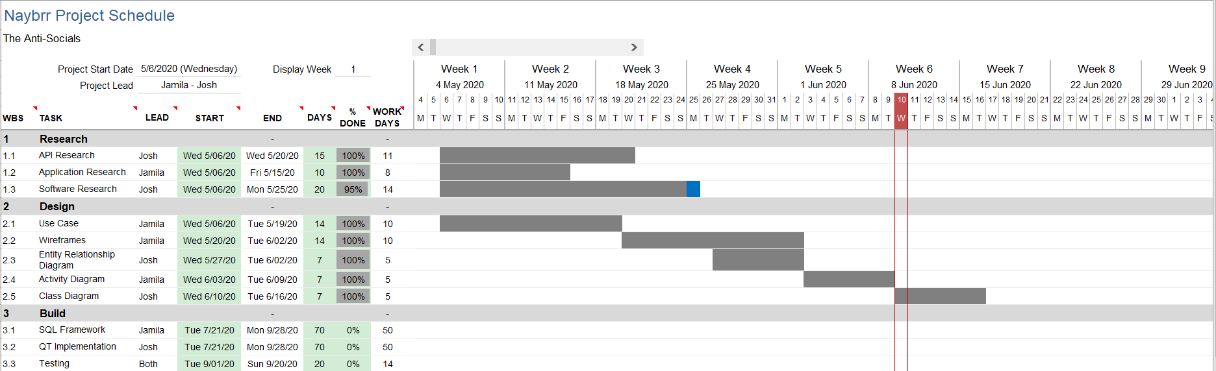
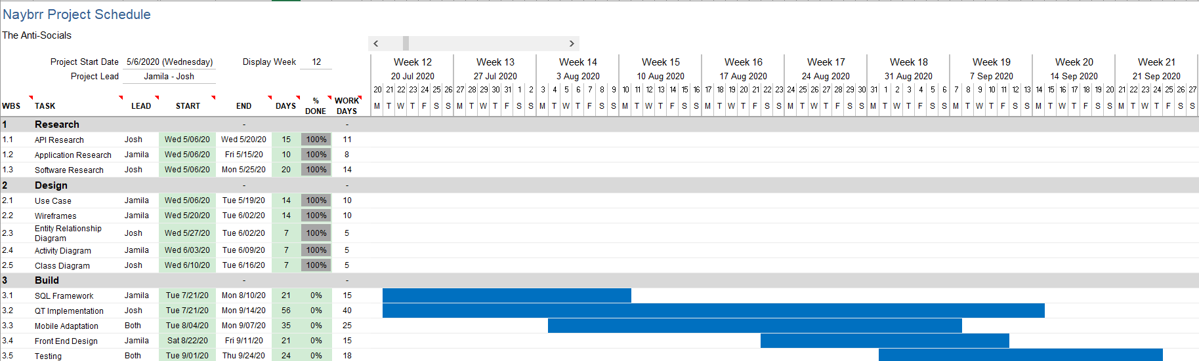
Timeline

Slide 5





Software

Slide 6
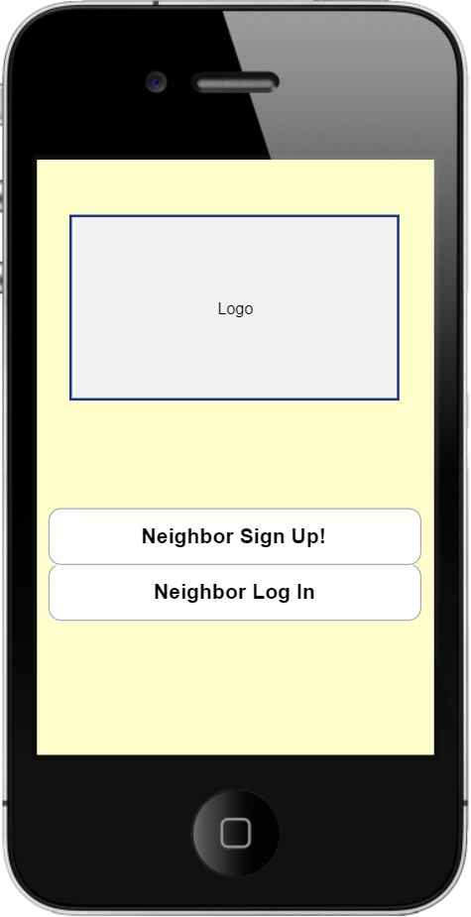
Home Page

Slide 7
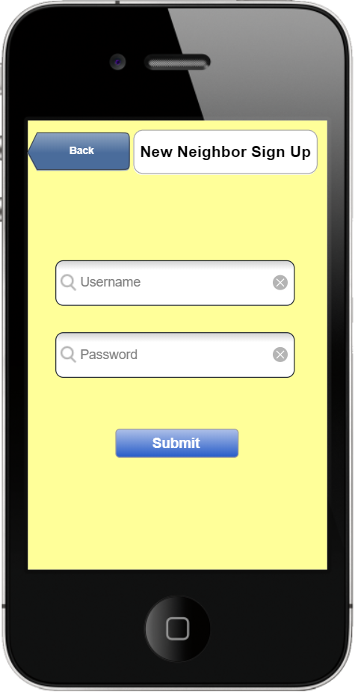
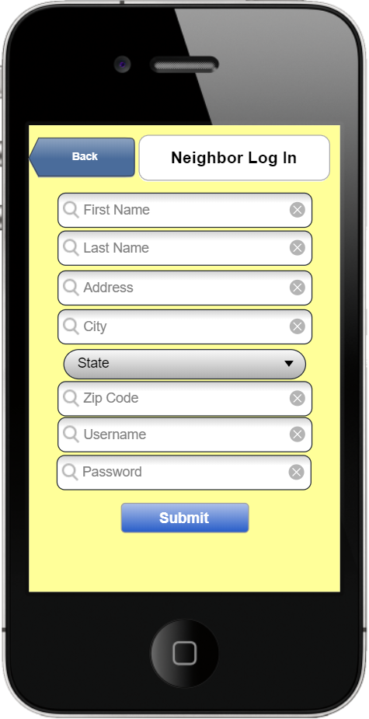
Log In Sign Up

Slide 8
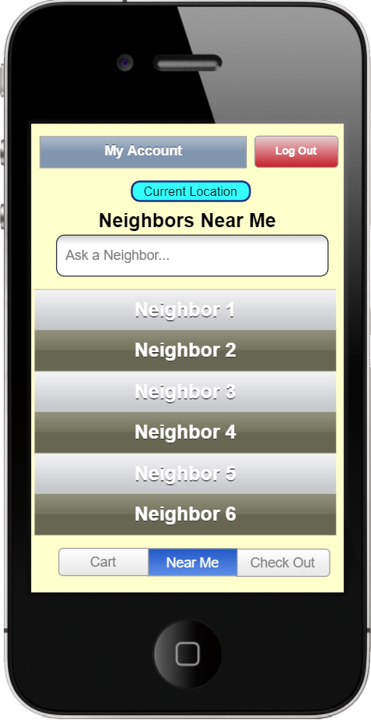
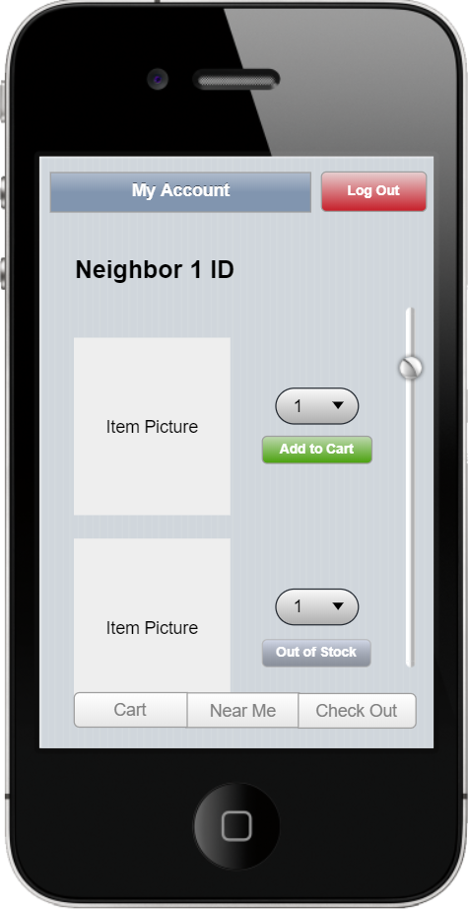
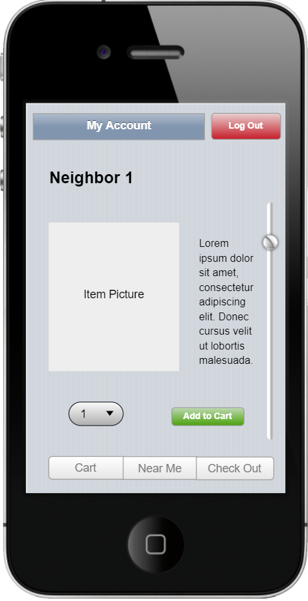
Neighbor Portal

Slide 9
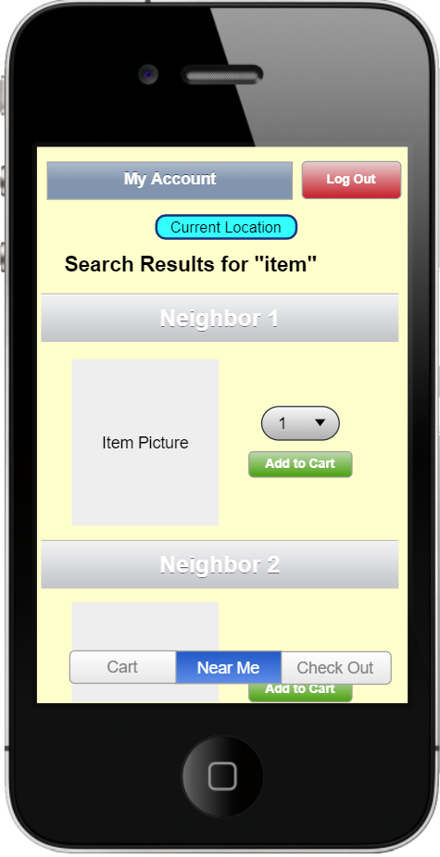
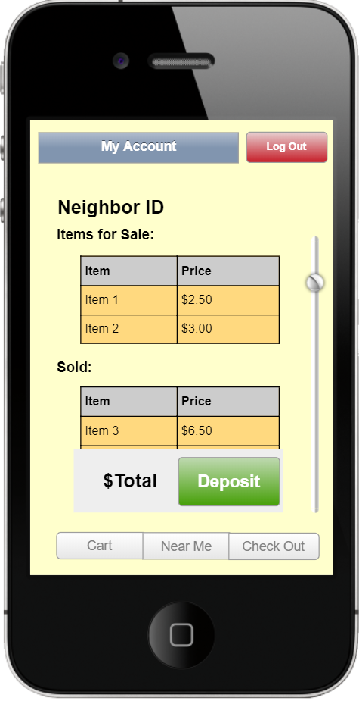
Search Balance

Slide 10
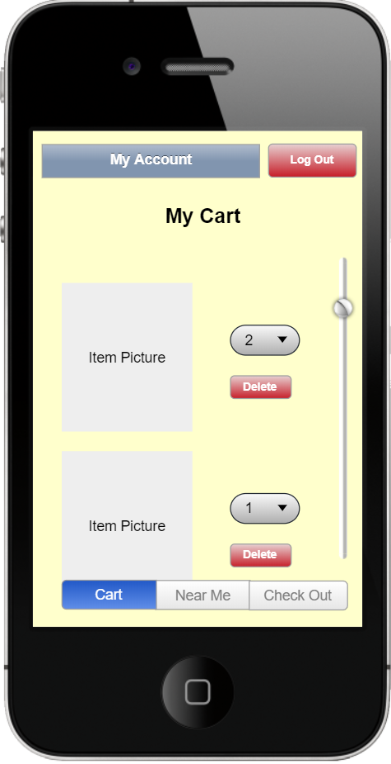
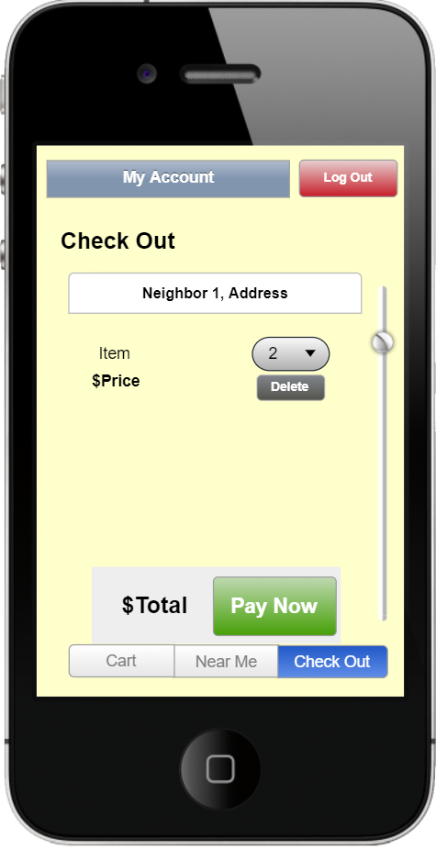
Cart Check Out

Slide 11
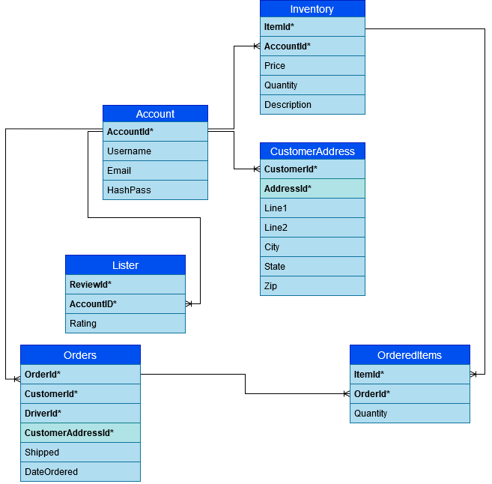
Entity Relationship Diagram

Slide 12
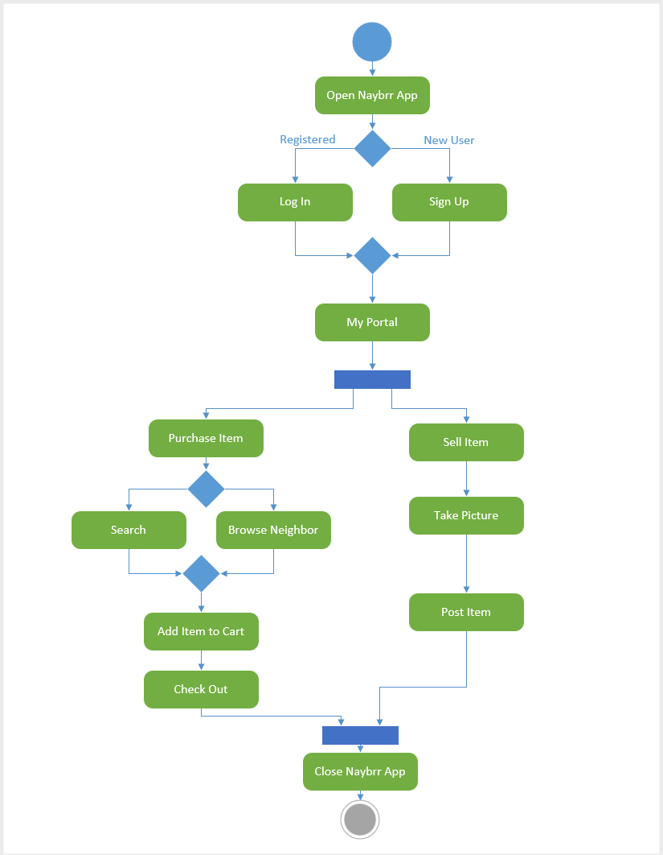
Activity Diagram

Slide 13
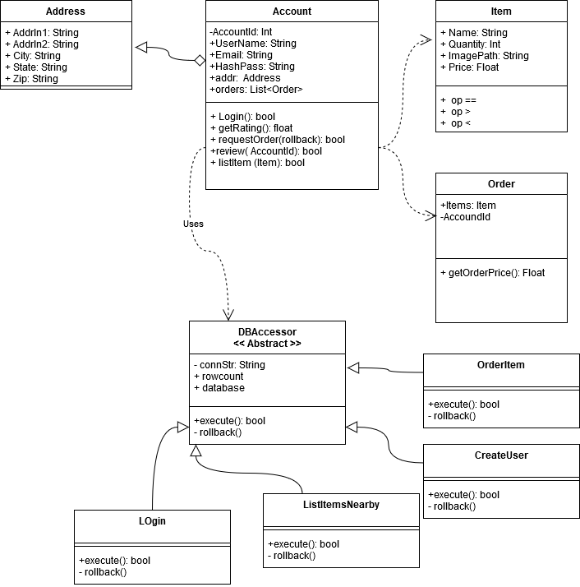
Class Diagram

Slide 14
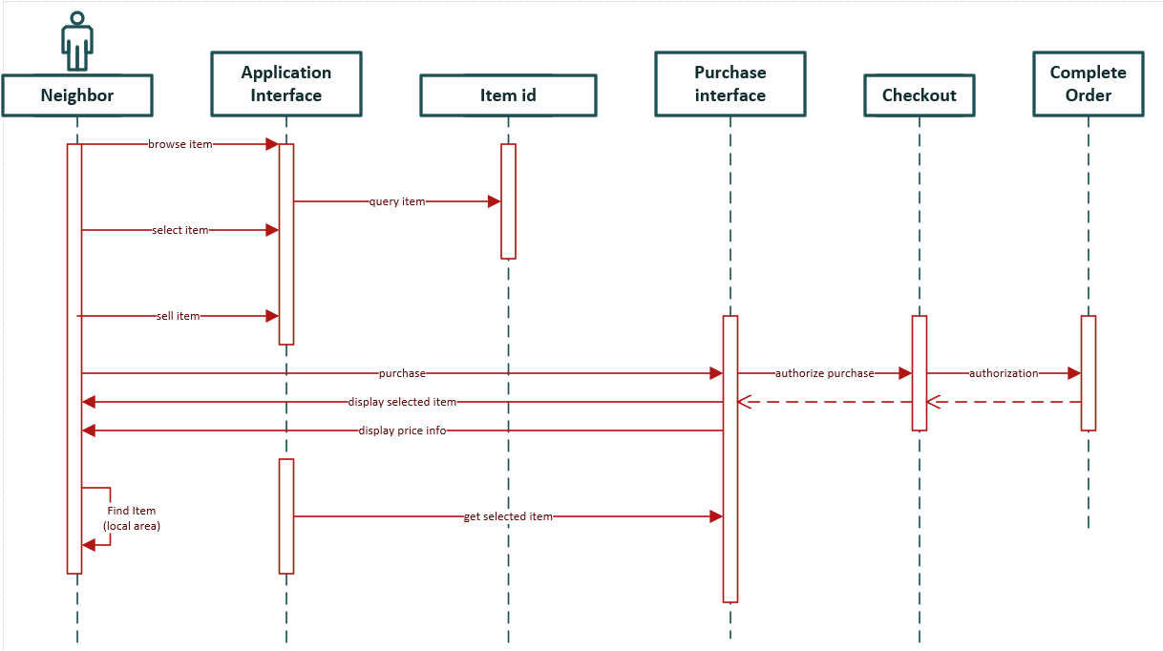
Sequence Diagram

Slide 15
Questions?

